Slide 1
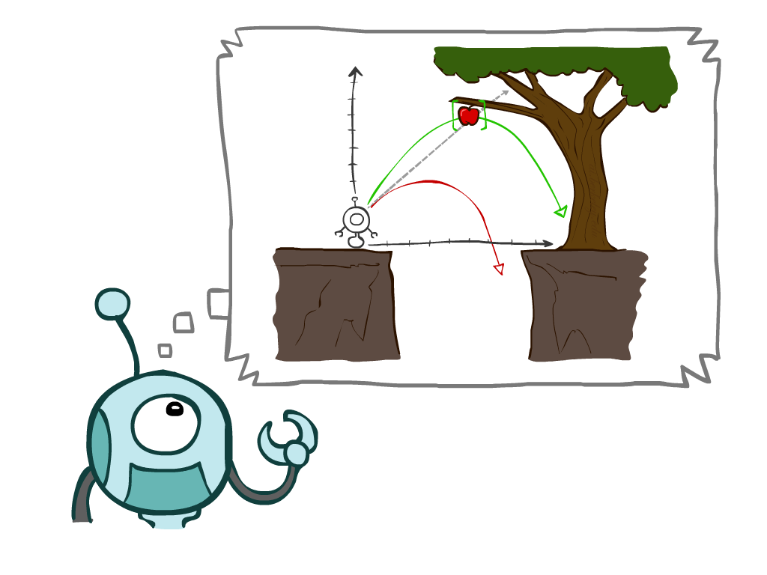
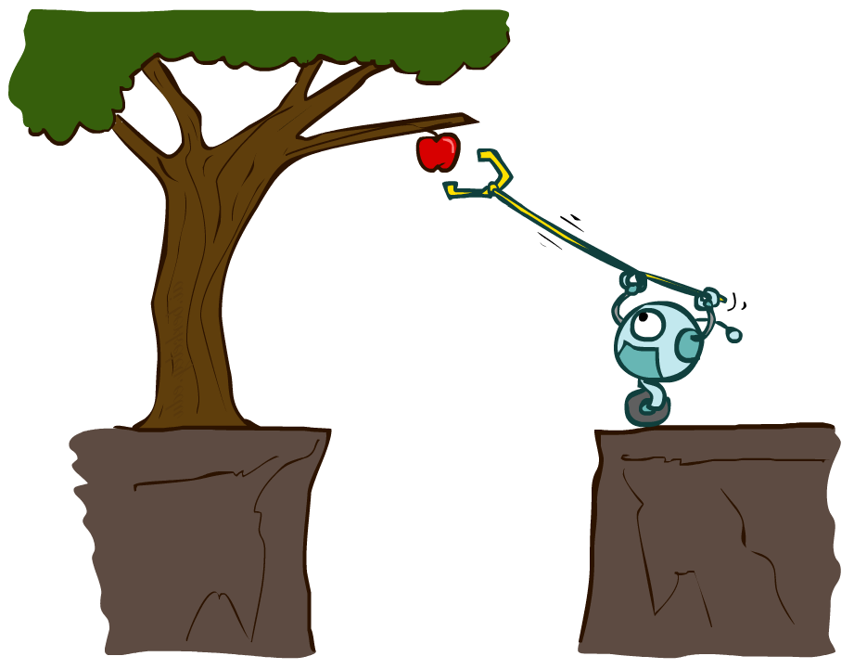
Artificial Intelligence
Ch2: Intelligent Agents
Part 1
Instructor: Iyad Alshami
[These slides adopted from Dan Klein and Pieter Abbeel at UC Berkeley ai.berkeley.edu]

Slide 2
Rational Agents
An agent is an entity that perceives and acts.
A rational agent selects actions that maximize its (expected) utility.
Characteristics of the percepts, environment, and action space dictate techniques for selecting rational actions
Sensors
Agent
Percepts
Environment
?
Actuators
Actions

Slide 3
This Chapter about
Agents And Environments
Good Behavior: The Concept Of Rationality
The Nature Of Environments
The Structure Of Agents

Slide 4
Agents And Environments
An agent is anything that can be viewed as perceiving its environment through sensors and acting upon that environment through actuators.
Sensors
Agent
Percepts
Environment
?
Actuators
Actions
Notes:
Human agent:
eyes, ears, and other organs for sensors;
hands, legs, mouth, and other body parts for actuators
Robotic agent:
cameras and infrared range finders for sensors
various motors for actuators

Slide 5
Agent function
An agent’s behavior is described by the agent function that maps any given percept sequence to an action.
the term percept refers to the agent’s perceptual inputs at any given instant. An agent’s percept sequence is the complete history of everything the agent has ever perceived.
The agent program runs on the physical architecture to produce the agent function
agent = architecture + program

Slide 6
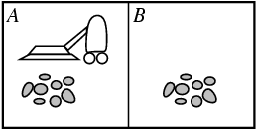
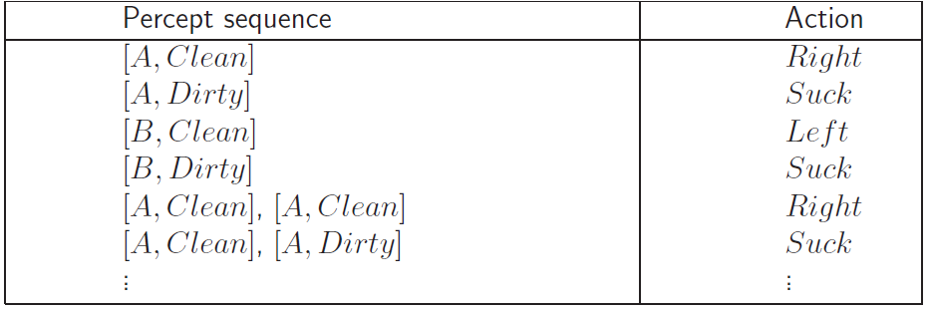
Vacuum-cleaner world
Percepts: location and contents, e.g., [A,Dirty]
Actions: Left, Right, Suck, Noop
Agent’s function → look-up table
For many agents this is a very large table
Notes:
Only 2 locations

Slide 7
Good Behavior: The Concept Of Rationality

Slide 8
Good Behavior: The Concept Of Rationality
Rationality depends on four things:
Performance measure that defines the criterion of success.
Agents prior knowledge of environment
Actions that agent can perform
Agent’s percept sequence to date
Rational Agent: For each possible percept sequence, a rational agent should select an action that is expected to maximize its performance measure, given the evidence provided by the percept sequence and whatever built-in knowledge the agent has.

Slide 9
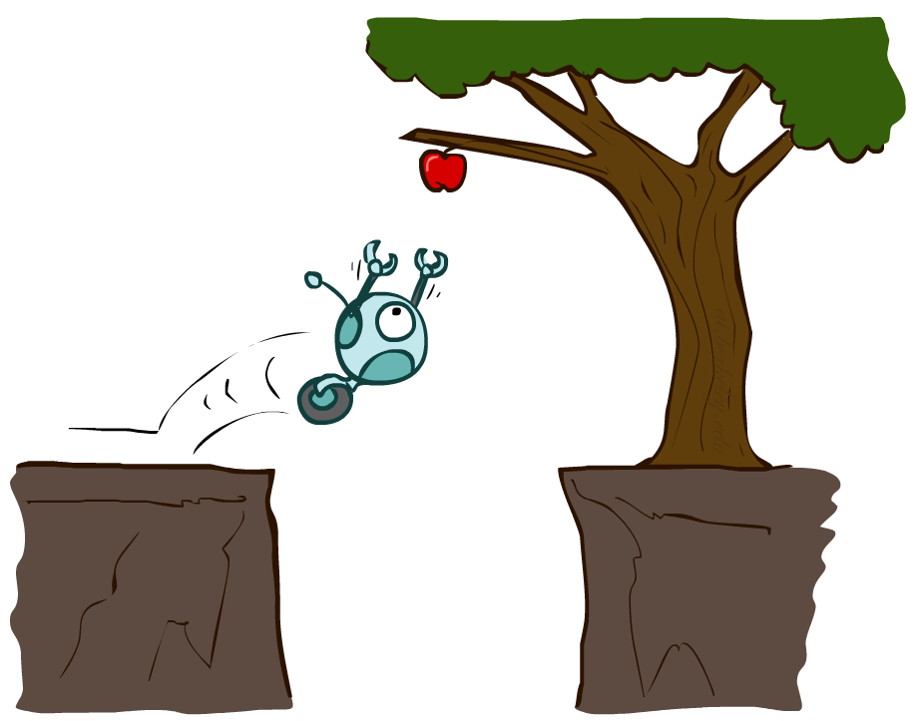
Rational agents
Performance measure (utility function): An objective criterion for success of an agent's behavior
Can a rational agent make mistakes?
Notes:
ExpectedUtility(action) = sum_outcomes Utility(outcome) * P(outcome)

Slide 10
Rational agents
Let us assume the following:
The performance measure awards one point for each clean square at each time step, over a “lifetime” of 1000 time steps.
The “geography” of the environment is known a priori but the dirt distribution and the initial location of the agent are not. Clean squares stay clean and sucking cleans the current square. The Left and Right actions move the agent left and right except when this would take the agent outside the environment, in which case the agent remains where it is.
The only available actions are Left, Right, and Suck.
The agent correctly perceives its location and whether that location contains dirt.

Slide 11
Rational agents
An omniscient agent knows the actual outcome of its actions and can act accordingly; but omniscience is impossible in reality.
Rational is different from omniscience
Percepts may not supply all relevant information
E.g., in card game, don’t know cards of others.
Rational is different from being perfect
Rationality maximizes expected outcome while perfection maximizes actual outcome.
Notes:
ämˈnisēənt اومنيشينت

Slide 12
Rational agents
A rational agent should choose the “looking” action before stepping, because looking helps maximize the expected performance.
Doing actions in order to modify future percepts—sometimes called information gathering.
A second example of information gathering is provided by the exploration that must be undertaken by an agent in an initially unknown environment.
The definition requires a rational agent not only to gather information but also to learn as much as possible from what it perceives.

Slide 13
Autonomy in Agents
The autonomy of an agent is the extent to which its behaviour is determined by its own experience, rather than knowledge of designer.
Example: baby learning to crawl
Extremes
No autonomy – ignores environment/data
Complete autonomy – must act randomly/no program
Ideal: design agents to have some autonomy
Possibly become more autonomous with experience

Slide 14
Back to vacuum-cleaner world
Percepts: location and contents, e.g., [A,Dirty]
Actions: Left, Right, Suck, Noop
function Vacuum-Agent([location, status]) returns an action
if status = Dirty then return Suck
else if location = A then return Right
else if location = B then return Left
Is this agent rational?
It depends on performance measure, environment properties

Slide 15
The Nature Of Environments

Slide 16
The Nature Of Environments
An agent is anything that can be viewed as perceiving its environment through sensors and acting upon that environment through actuators.
Specific environment no agent can do in every environment, since that each environments come in a variety of flavors. The flavor of the environment directly affects the appropriate design for the agent program.
The environments “Task environments”, are essentially the “problems” to which rational agents are the “solutions.”

Slide 17
Specifying the Task Environment
In designing an agent, the first step must always be to specify the task environment as fully as possible.
Problem specification: (PEAS) Performance measure, Environment, Actuators, Sensors
the setting for intelligent agent design
Consider, for example, the task of designing an automated taxi driver.

Slide 18
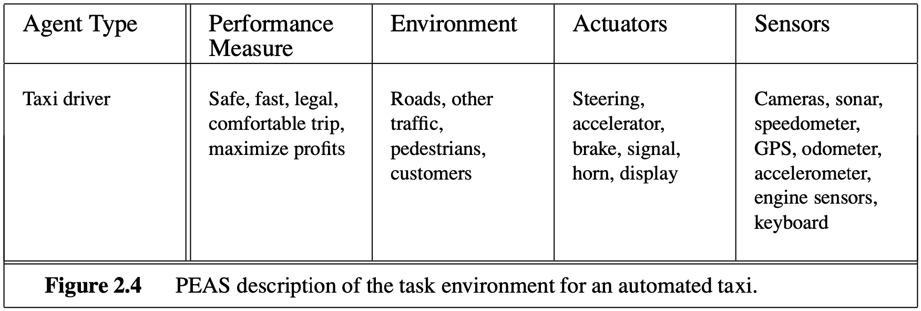
Specifying the Task Environment
Consider, for example, the task of designing an automated taxi driver:
Notes:
Performance measure: Safe, fast, legal, comfortable trip, maximize profits
Environment: Roads, other traffic, pedestrians, customers
Actuators: Steering wheel, accelerator, brake, signal, horn
Sensors: Cameras, sonar, speedometer, GPS, odometer, engine sensors, keyboard

Slide 19
Environment Types
Fully observable (vs. partially observable): The agent's sensors give it access to the complete state of the environment at each point in time
Deterministic (vs. stochastic): The next state of the environment is completely determined by the current state and the agent’s action
Strategic: the environment is deterministic except for the actions of other agents
Episodic (vs. sequential): The agent's experience is divided into atomic “episodes,” and the choice of action in each episode depends only on the episode itself

Slide 20
Environment types
Static (vs. dynamic): The environment is unchanged while an agent is deliberating
Semi-dynamic: the environment does not change with the passage of time, but the agent's performance score does
Discrete (vs. continuous): The environment provides a fixed number of distinct percepts, actions, and environment states
Time can also evolve in a discrete or continuous fashion
Single agent (vs. multi-agent): An agent operating by itself in an environment

Slide 21
Environment types
Known (vs. unknown): The agent knows the rules of the environment

Slide 22
Examples of different environments

Slide 23
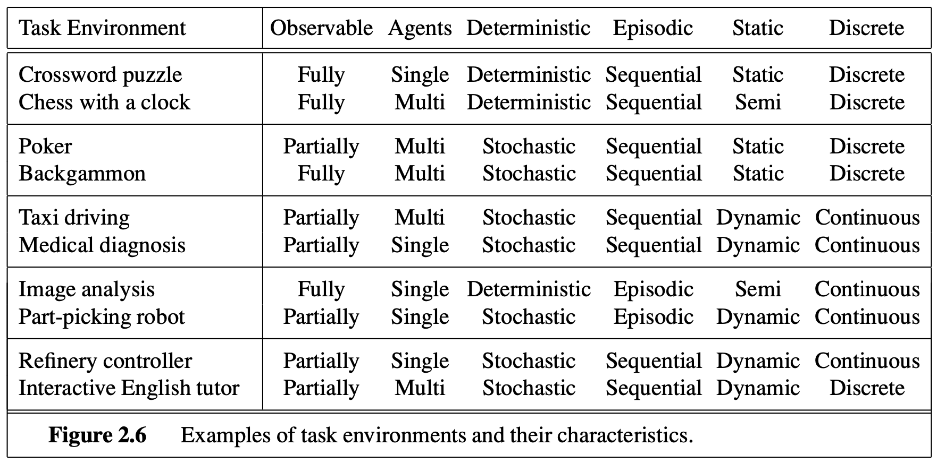
Examples of different environments

Slide 24
The Structure Of Agents

Slide 25
The Structure Of Agents
The job of AI is to design an agent program that implements the agent function— the mapping from percepts to actions.
This agent program will run on some sort of computing device with physical sensors and actuators—call this the architecture:
agent = architecture + program
Hence, the program has to be one that is appropriate for the architecture.
If the program is going to recommend actions like Walk, the architecture had better have legs.

Slide 26
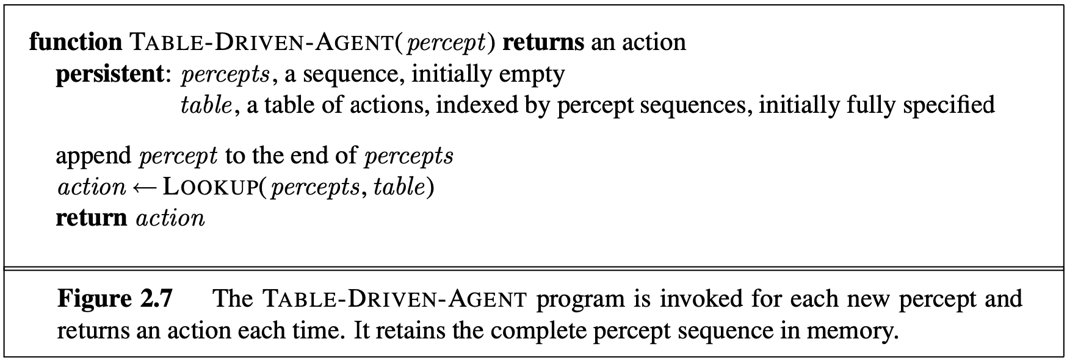
Agent Program
The agent programs have a skeleton, they take the current percept as input from the sensors and return an action to the actuators.
if the agent’s actions need to depend on the entire percept sequence, the agent will have to remember the percepts.
Notes:
To build a rational agent in this way, we as designers must construct a table that contains the appropriate action for every possible percept sequence.

Slide 27
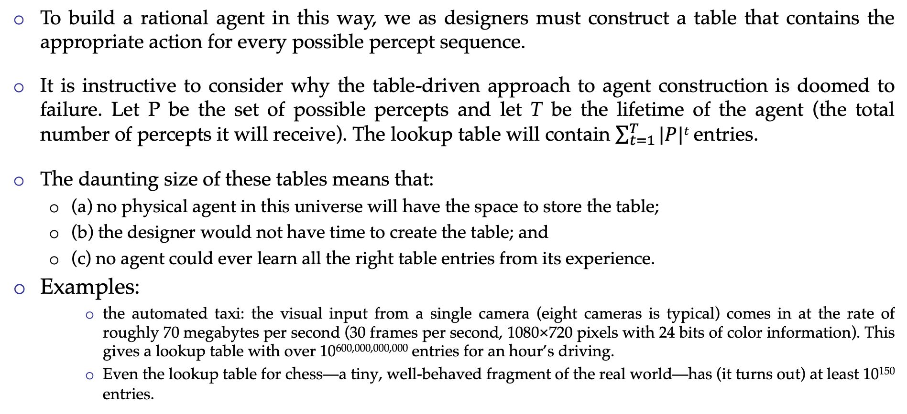
Table-Driven-Agent
To build a rational agent in this way, we as designers must construct a table that contains the appropriate action for every possible percept sequence.
It is instructive to consider why the table-driven approach to agent construction is doomed to failure. Let P be the set of possible percepts and let T be the lifetime of the agent (the total number of percepts it will receive). The lookup table will contain $\sum_{t=1}^{T}{|P|t}$entries.
The daunting size of these tables means that:
(a) no physical agent in this universe will have the space to store the table;
(b) the designer would not have time to create the table; and
(c) no agent could ever learn all the right table entries from its experience.
Examples:
the automated taxi: the visual input from a single camera (eight cameras is typical) comes in at the rate of roughly 70 megabytes per second (30 frames per second, 1080×720 pixels with 24 bits of color information). This gives a lookup table with over 10^{600,000,000,000} entries for an hour’s driving.
Even the lookup table for chess—a tiny, well-behaved fragment of the real world—has (it turns out) at least 10¹⁵⁰ entries.

Slide 28
Table-Driven-Agent
The key challenge for AI is to find out how to write programs that, to the extent possible, produce rational behavior from a smallish program rather than from a vast table.

Slide 29
Agent Types
There are four basic kinds of agent programs that embody the principles underlying almost all intelligent systems:
Simple reflex agents
Model-based reflex agents
Goal-based agents
Utility-based agents
Learning Agents

Slide 30
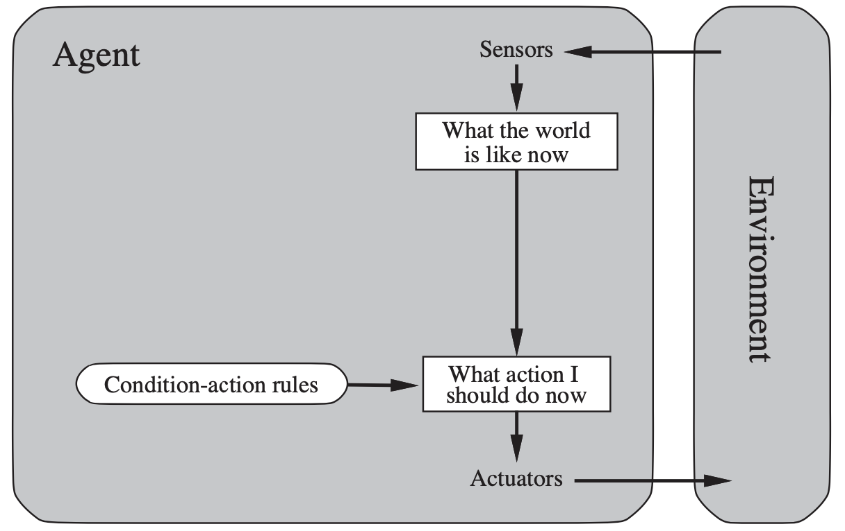
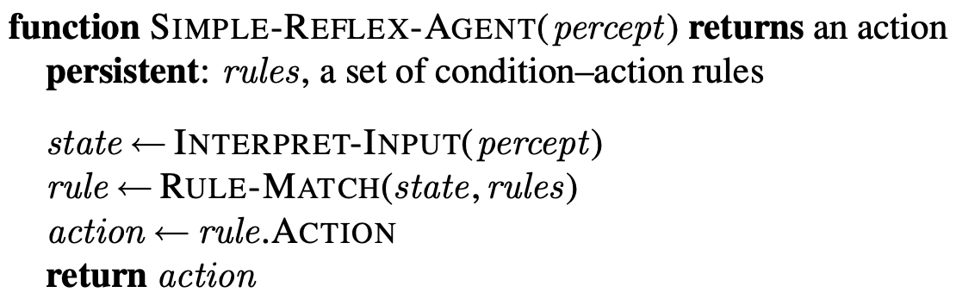
Simple reflex agent
Select action on the basis of current percept, ignoring all past percepts
A simple reflex agent. It acts according to a rule whose condition matches the current state, as defined by the percept.
Notes:
condition–action rules, situation–action rules, productions, or if–then rules
*** Simple reflex agents have the admirable property of being simple, but they turn out to be of limited intelligence

Slide 31
Model-based reflex agent
Maintains internal state that keeps track of aspects of the environment that cannot be currently observed

Slide 32
Model-based reflex agent
Updating the internal state information as time goes by requires two kinds of knowledge to be encoded in the agent program.
First, we need some information about how the world evolves independently of the agent
for example, that an overtaking car generally will be closer behind than it was a moment ago.
Second, we need some information about how the agent’s own actions affect the world
for example, that when the agent turns the steering wheel clockwise, the car turns to the right, or that after driving for five minutes northbound on the freeway, one is usually about five miles north of where one was five minutes ago.
This knowledge about “how the world works”—whether implemented in simple Boolean circuits or in complete scientific theories—is called a model of the world. An agent that uses such a model is called a model-based agent.

Slide 33
Model-based reflex agent (4th Edition)
Updating the internal state information as time goes by requires two kinds of knowledge to be encoded in the agent program.
First, we need some information about how the world changes over time, which can be divided roughly into two parts: the effects of the agent’s actions and how the world evolves independently of the agent.
For example, when the agent turns the steering wheel clockwise, the car turns to the right, and when it’s raining the car’s cameras can get wet.
This knowledge about “how the world works”—whether implemented in simple Boolean circuits or in complete scientific theories—is called a transition model of the world.
Second, we need some information about how the state of the world is reflected in the agent’s percepts.
For example, when the car in front initiates braking, one or more illuminated red regions appear in the forward-facing camera image, and, when the camera gets wet, droplet-shaped objects appear in the image partially obscuring the road.
This kind of knowledge is called a sensor model.

Slide 34
Model-based reflex agent(4th Edition)
Together, the transition model and sensor model allow an agent to keep track of the state of the world—to the extent possible given the limitations of the agent’s sensors. An agent that uses such a model is called a model-based agent.

Slide 35
Goal-based agent
The agent uses goal information to select between possible actions in the current state.
Notes:
Sometimes goal-based action selection is straightforward—for example, when goal sat- isfaction results immediately from a single action. Sometimes it will be more tricky—for example, when the agent has to consider long sequences of twists and turns in order to find a way to achieve the goal. Search (Chapters 3, 4, and 6) and planning (Chapter 11) are the subfields of AI devoted to finding action sequences that achieve the agent’s goals.

Slide 36
Goal-based agent
Knowing something about the current state of the environment is not always enough to decide what to do.
For example, at a road junction, the taxi can turn left, turn right, or go straight on. The correct decision depends on where the taxi is trying to get to.
In other words, as well as a current state description, the agent needs some sort of goal information that describes situations that are desirable
for example, being at the passenger’s destination.
The agent program can combine this with the model (the same information as was used in the model- based reflex agent) to choose actions that achieve the goal.

Slide 37
Utility-based agent
The agent uses a utility function to evaluate the desirability of states that could result from each possible action.

Slide 38
Utility-based agent
Goals alone are not enough to generate high-quality behavior in most environments.
For example, many action sequences will get the taxi to its destination (thereby achieving the goal) but some are quicker, safer, more reliable, or cheaper than others.
Goals just provide a crude binary distinction between “happy” and “unhappy” states.
A more general performance measure should allow a comparison of different world states according to exactly how happy they would make the agent.
Because “happy” does not sound very scientific, economists and computer scientists use the term utility instead.
Utility function maps a state or a sequence of states onto a real number => degree of happiness

Slide 39
Learning agents
Where does learning come in?

Slide 40
Learning agents
A learning agent can be divided into four conceptual components.
Critic, learning element, performance element, & problem generator.
The most important distinction is between the learning element, which is responsible for making improvements, and the performance element, which is responsible for selecting external actions.
Performance element is what was previously the whole agent
Input sensor
Output action
Learning element
Modifies performance element.

Slide 41
Learning agents
The learning element uses feedback from the critic on how the agent is doing and determines how the performance element should be modified to do better in the future.
The last component of the learning agent is the problem generator. It is responsible for suggesting actions that will lead to new and informative experiences.

